Slide 1



Out Of Range team
Dr / Asmaa Saad
Eng / Ahmed Abd Elsalam

Slide 2
Memebers Roles
Ebrahim Mohammed : Team Leader
Nouran Hashad : Presenter
Ahmed Abdullah : Documenter
Marwa Samir : Designer
Rowaida Anter : Tester

Slide 3

Agenda:
Problem definition
Introduction
ERD
Schema
Relationships
Tables
Forms
Reports

Slide 4
Introduction (DB, IS, Access)

Slide 5
Problem Definition
Faculty of CS management project using MS Access, project contain Students and Teachers And Courses And Department.
Every student has: ID, First Name, Last Name, Gender, Guardian Name, Gouvernorat, City, Department, Section, Phone No, Email, Joining and Leaving Date, Reason Of Leaving, Picture of Student, Emergency No and Birth Date.
Every Teacher has : ID, First and Last Name, Gender, Salary, The course he teachs, where each teacher teachs only one course, Address, Profile Photo, Rate, And Birth Date.
Both Teacher and Student has own Username and Password .
there exist many relationships like :
1 : M Between Student And Department
M : N Between Student And Courses
1 : 1 Between Enrollment And Grades
1 : 1 Between Teachers And Courses
the project contain 3 basic forms :
1 - main form of students contain full information of student who login and his grades of course.. etc
2 - main form of teachers contain full information of teacher who login and list of student he teachs..
3 - main form of admins contain all student informations and search bar can search about any sudent and teachers
Any form from Above contain a bottom to print a report of informaiton about student of teacher
and the project contain many query like qrystudent contain main information about student that show in student form like full name: [Firstname] & [Lastname], Address and Age.. etc

Slide 6

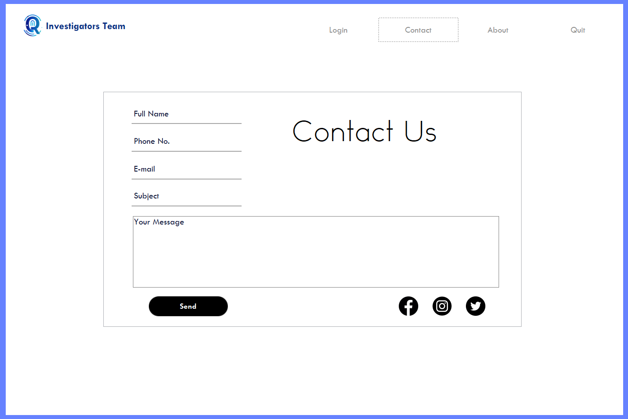
Forms
Start
Login
Contact Us

Slide 7
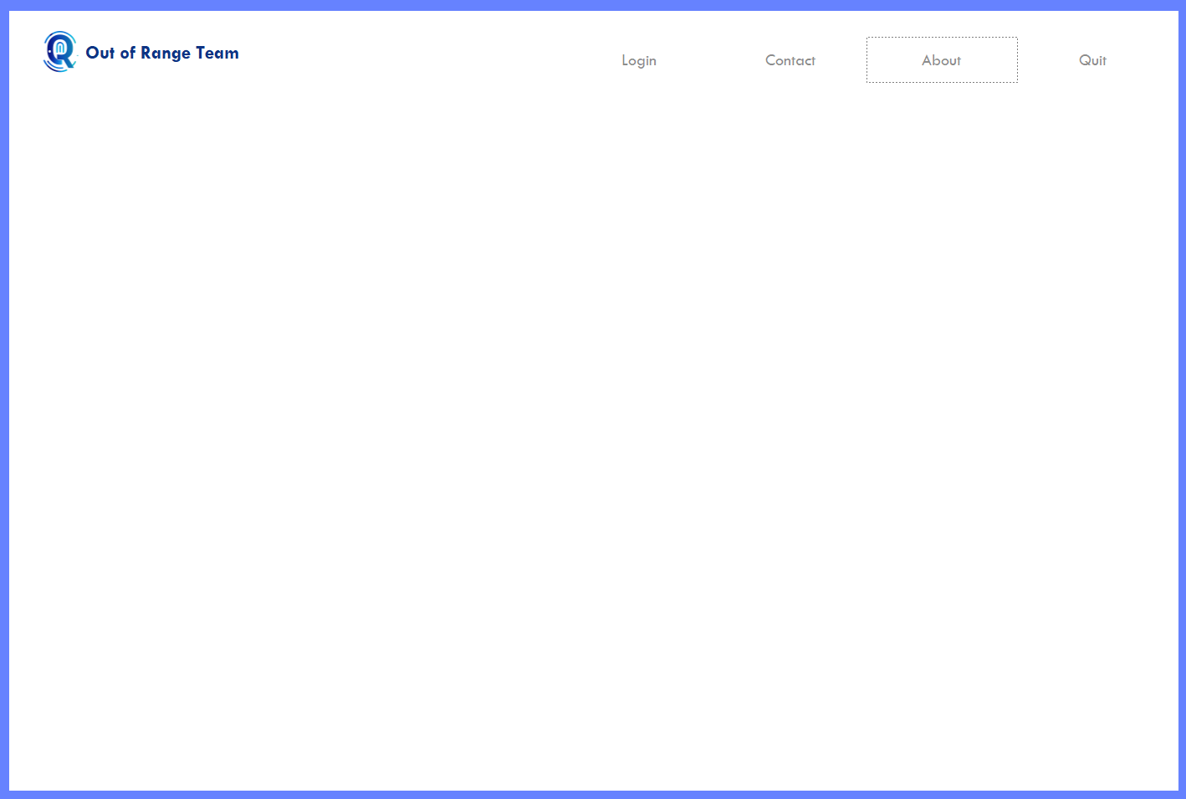
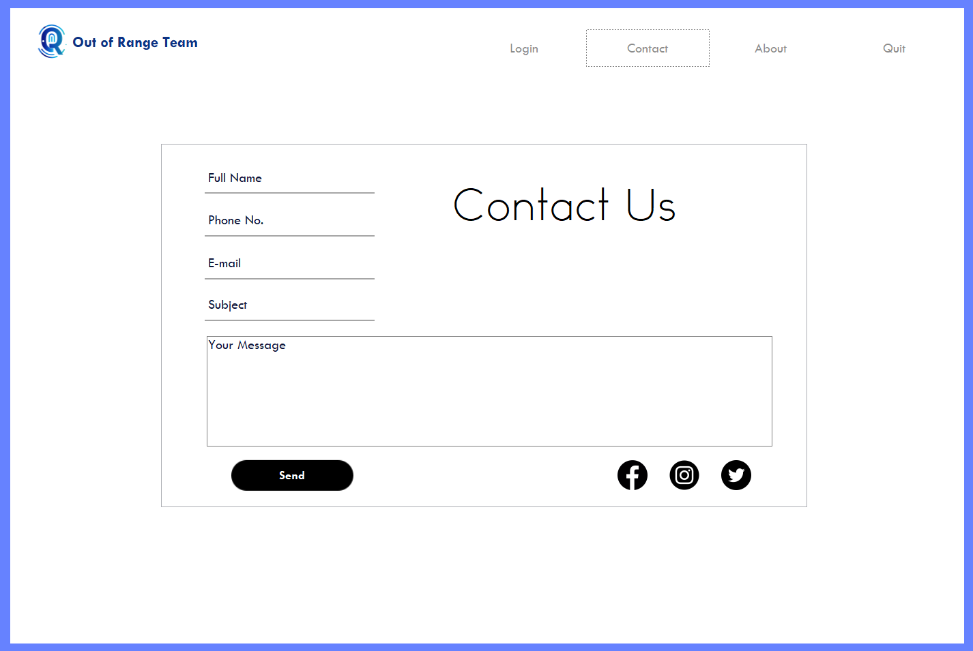

Start
About
Contact
Login

Slide 8
Start
Contact

Slide 9
Start
Login

Slide 10
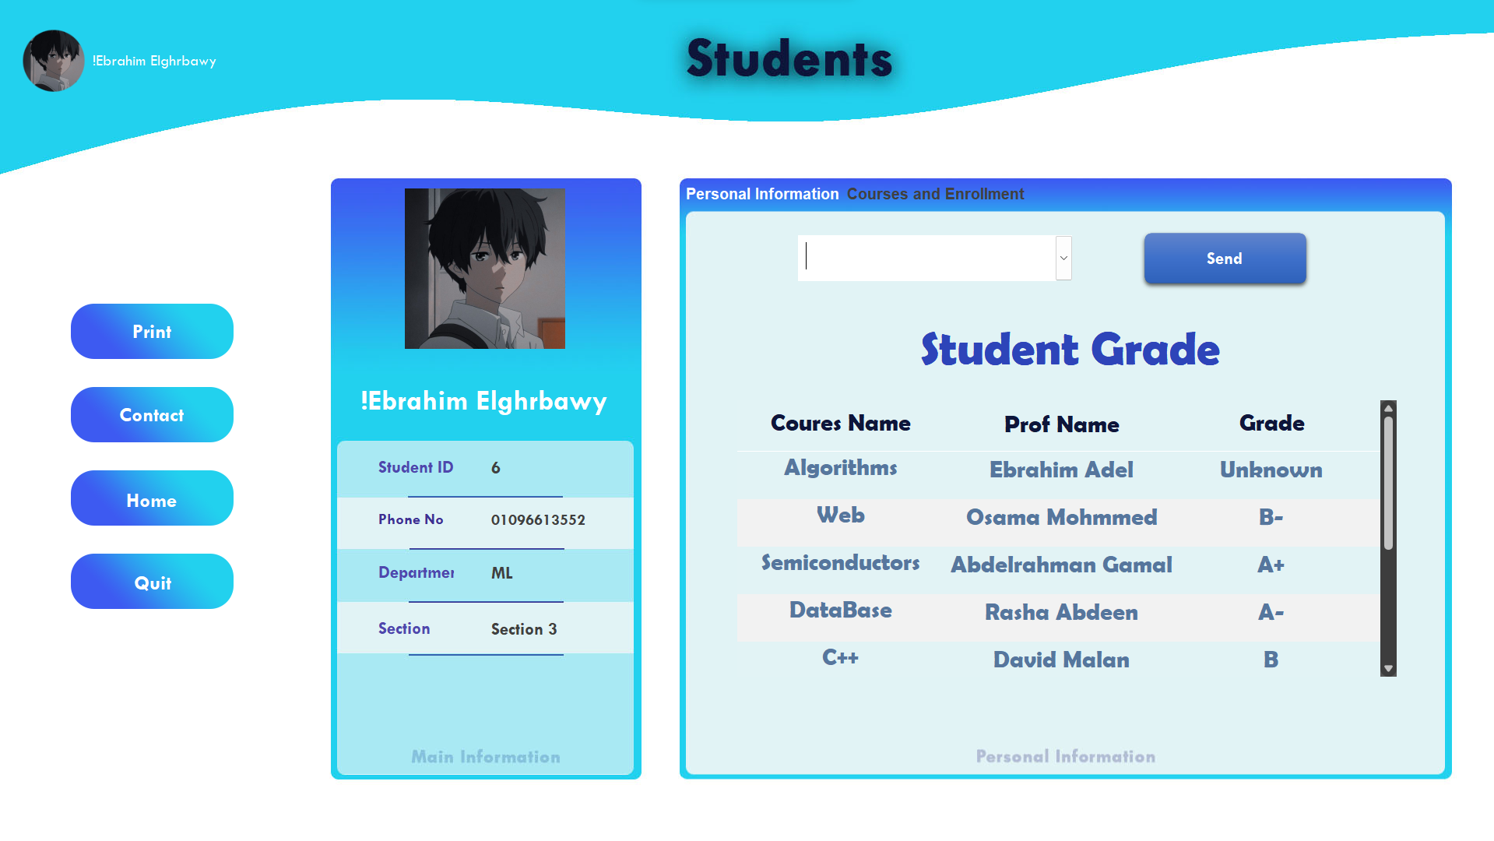




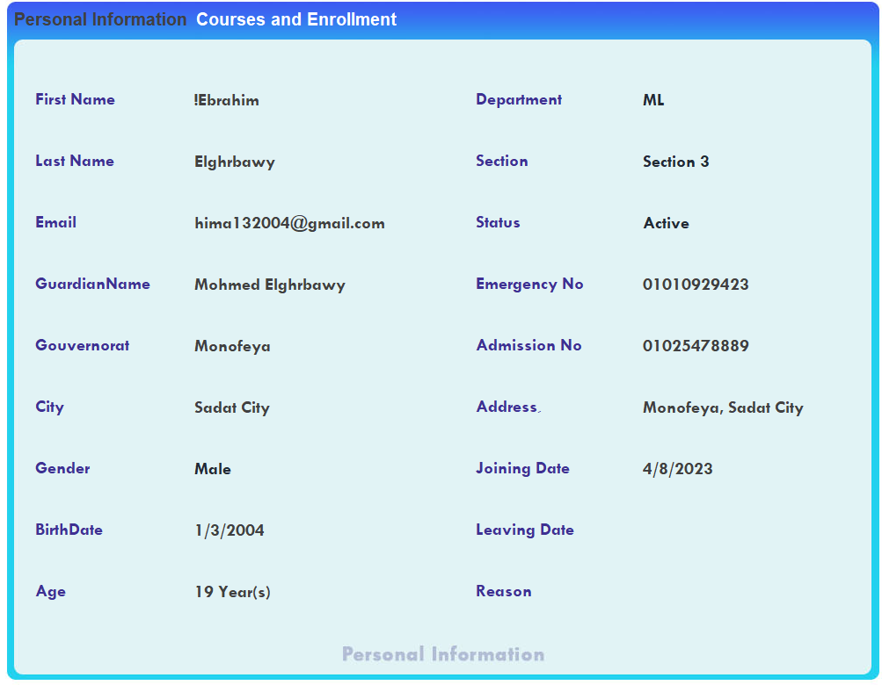
Enrollment & Requests
Student
Main Information
Personal Information

Slide 11
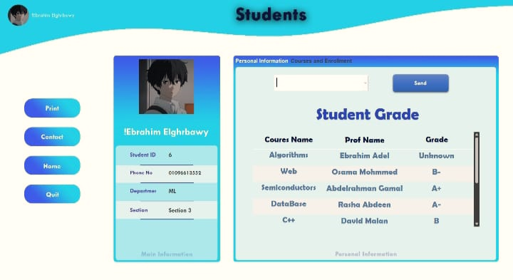
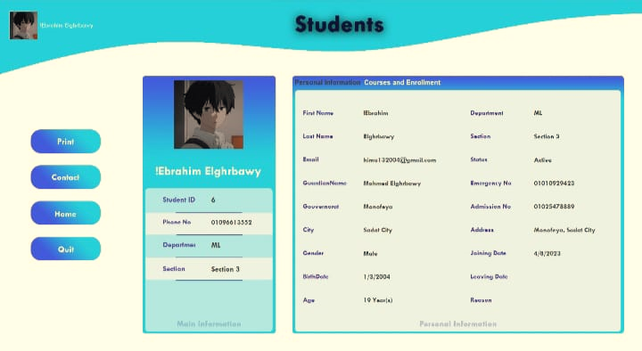
FORMS
Forms student(courses and information
Forms student(personnel information

Slide 12
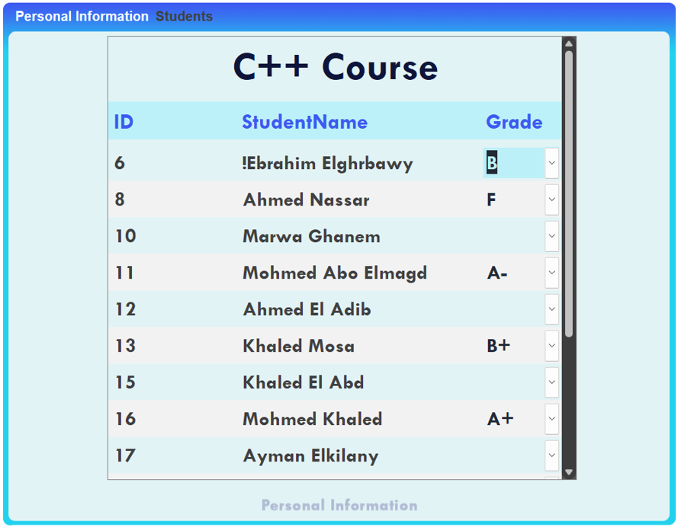
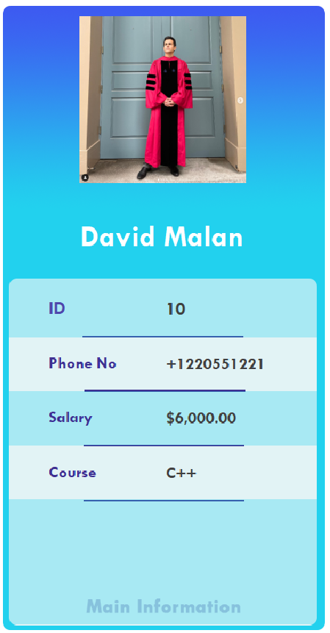
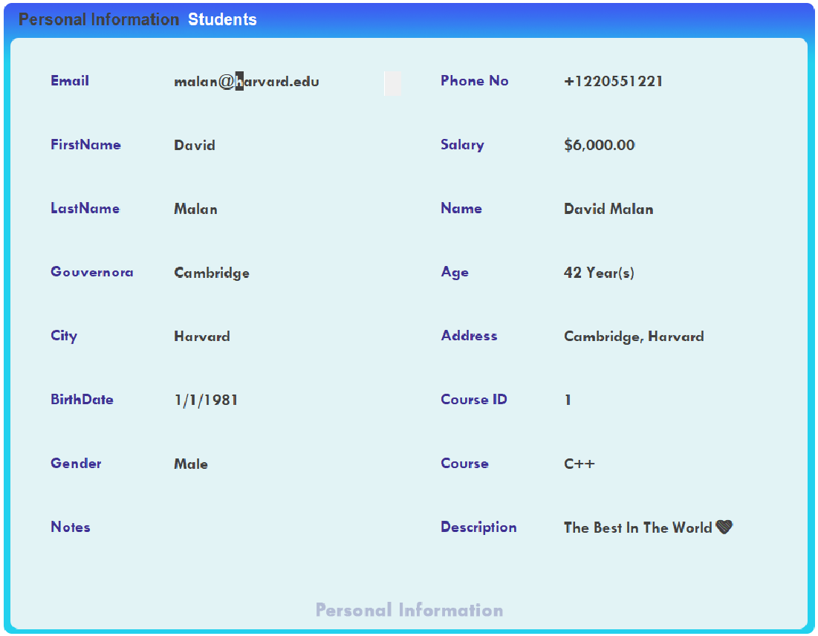
Students
Professors
Main Information
Personal Information

Slide 13
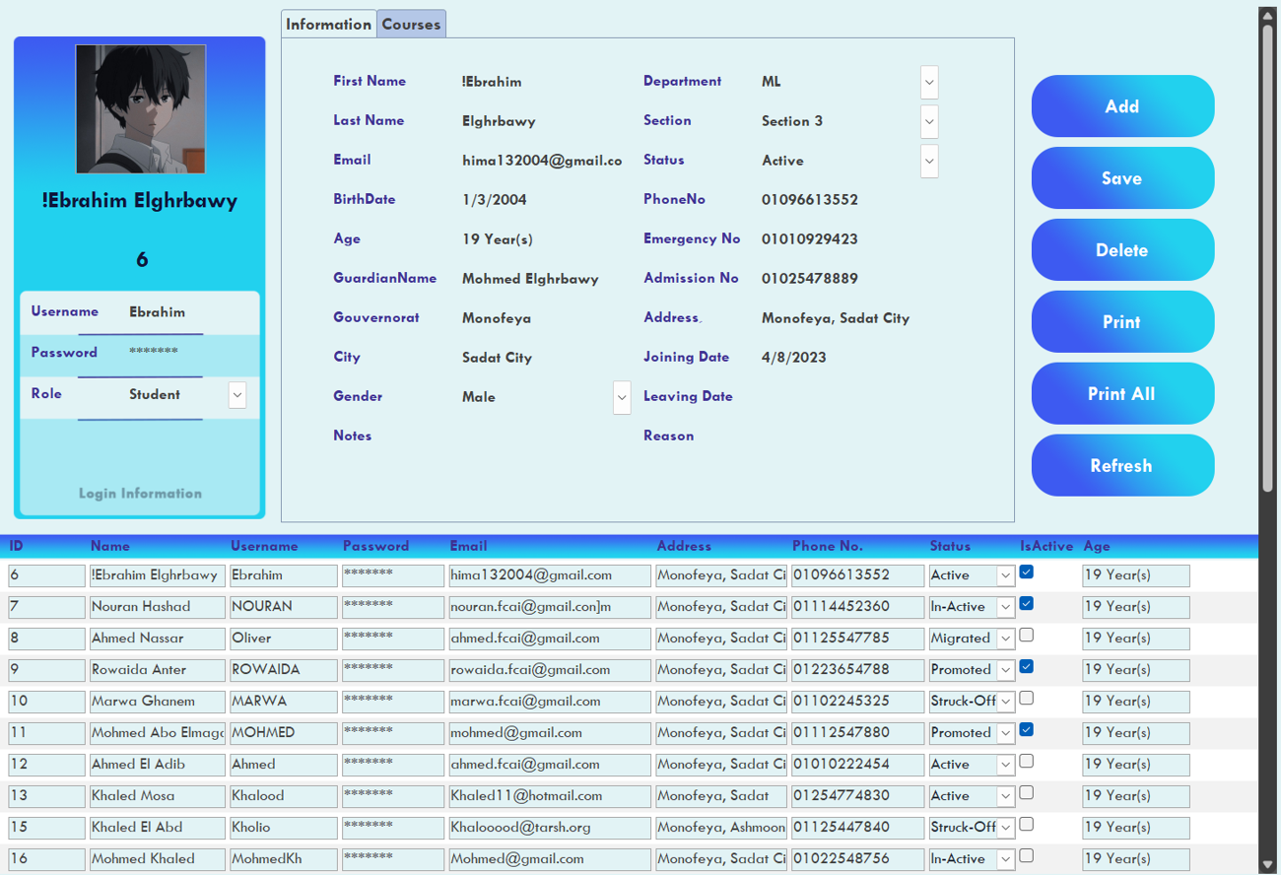
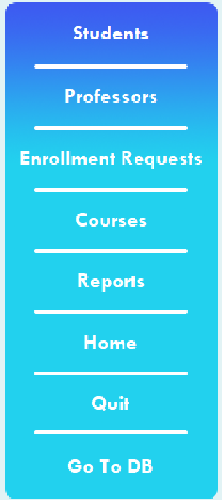
Admin
Students

Slide 14
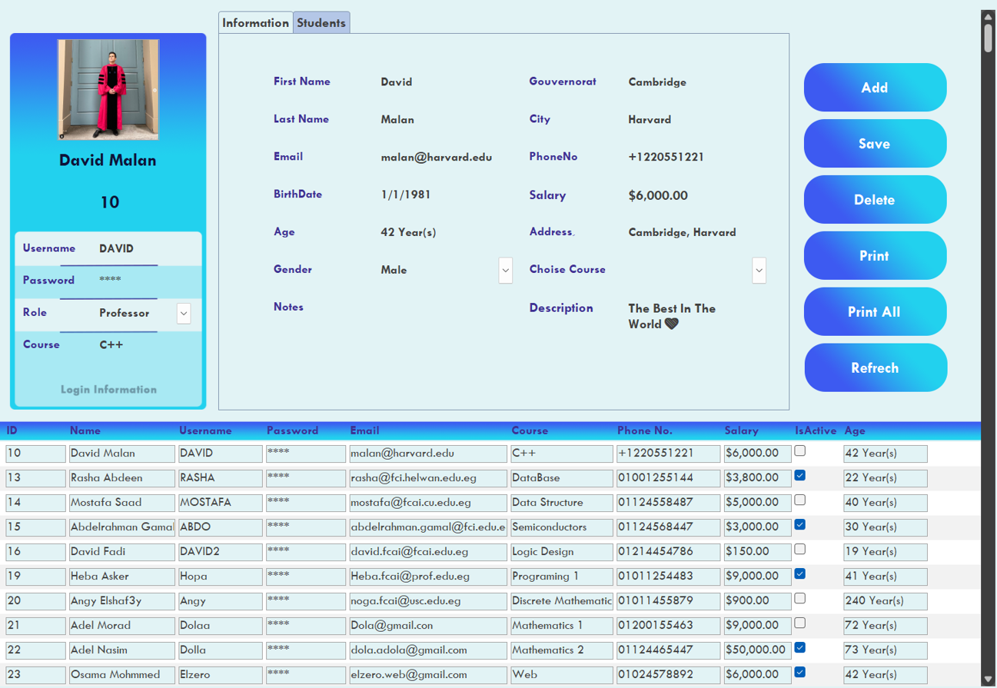
Admin
Professors

Slide 15
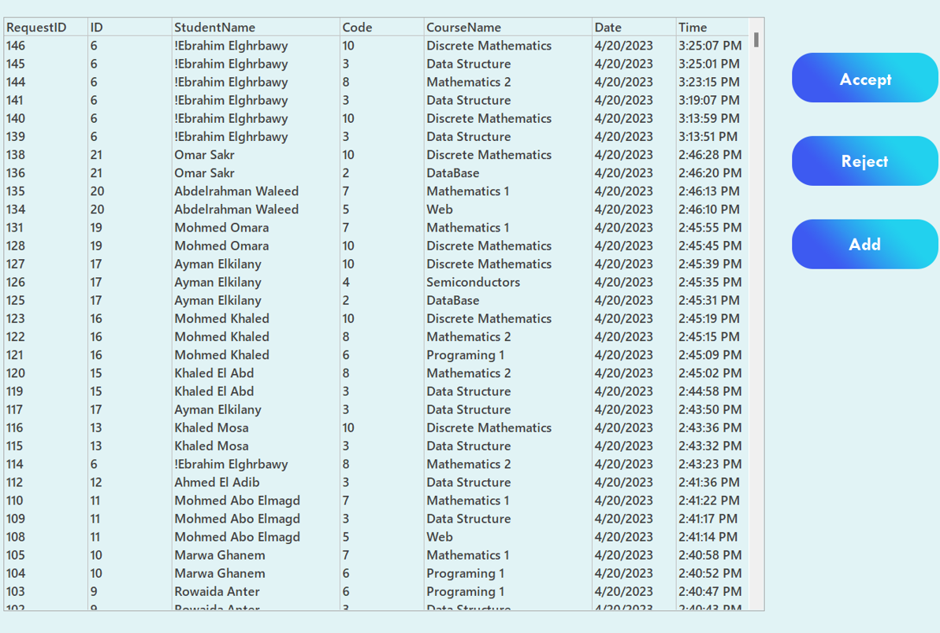
Admin
Enrollment Requests

Slide 16
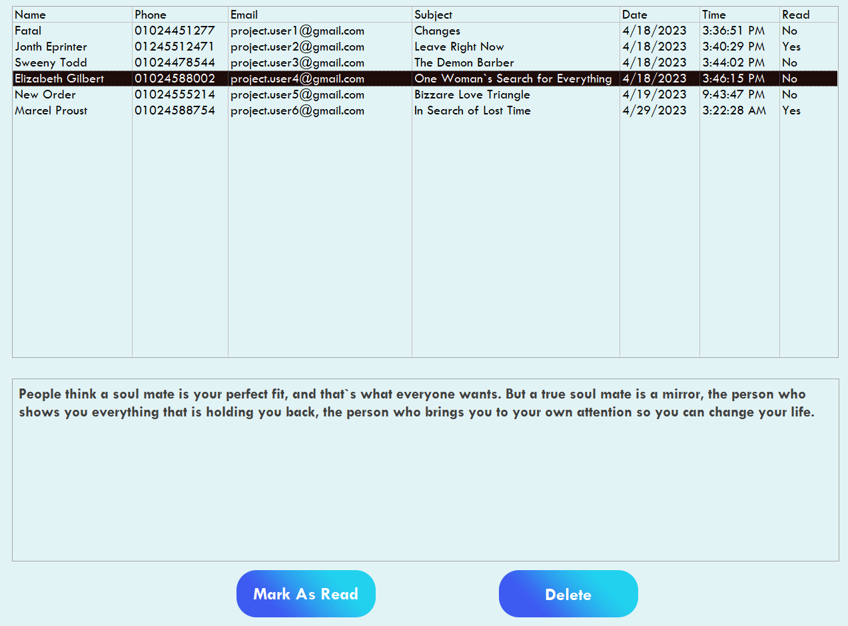
Admin
Reports

Slide 17
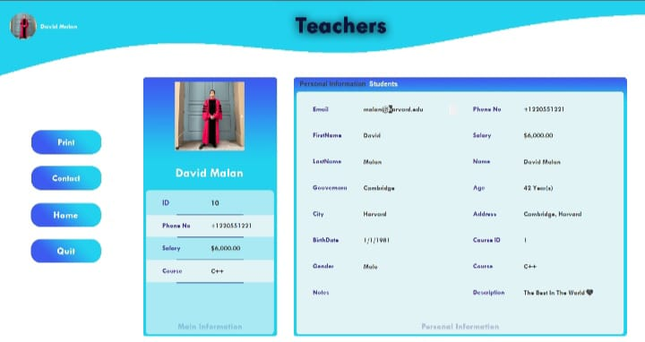
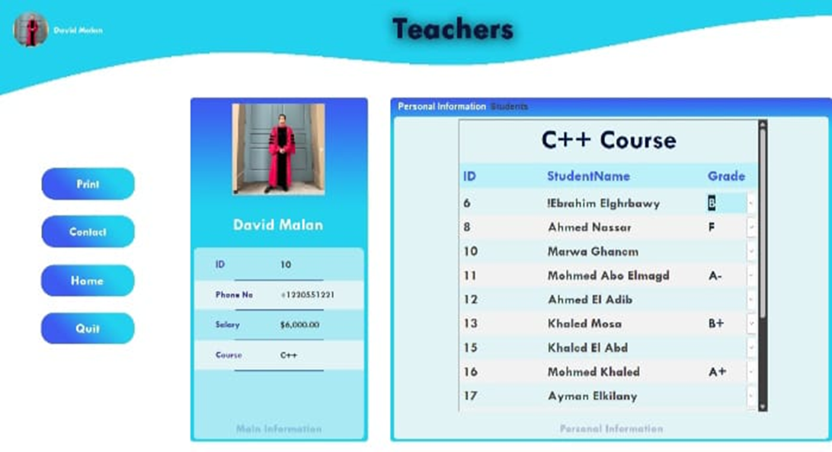
FORM TEACHER STUDENT
FORM TEACHER PERSONNEL INFORMATION

Slide 18
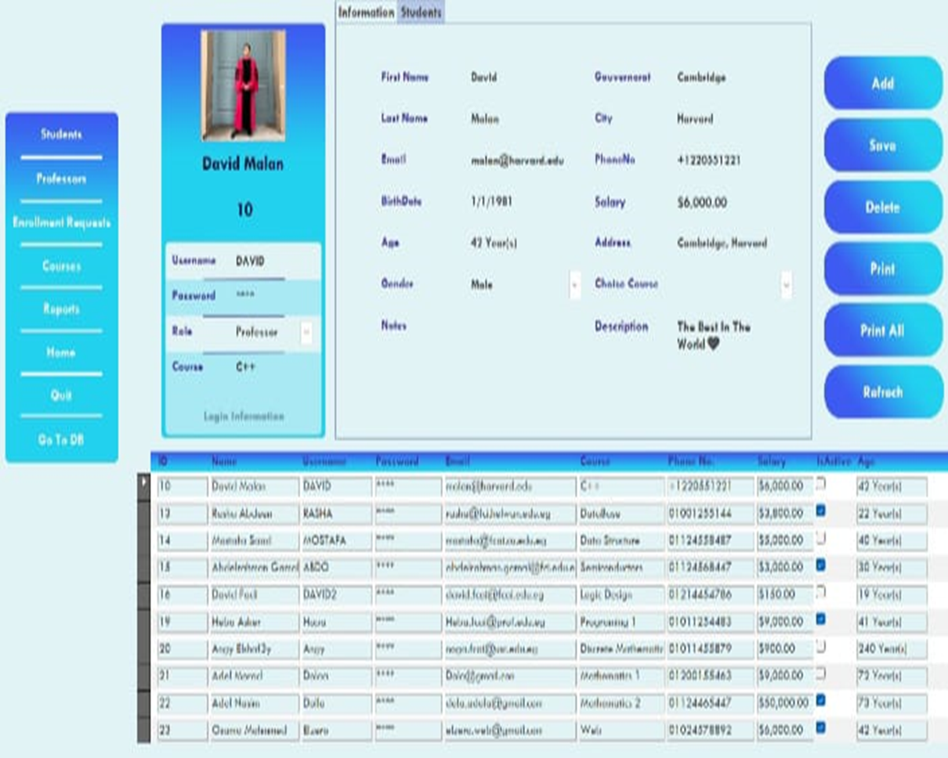
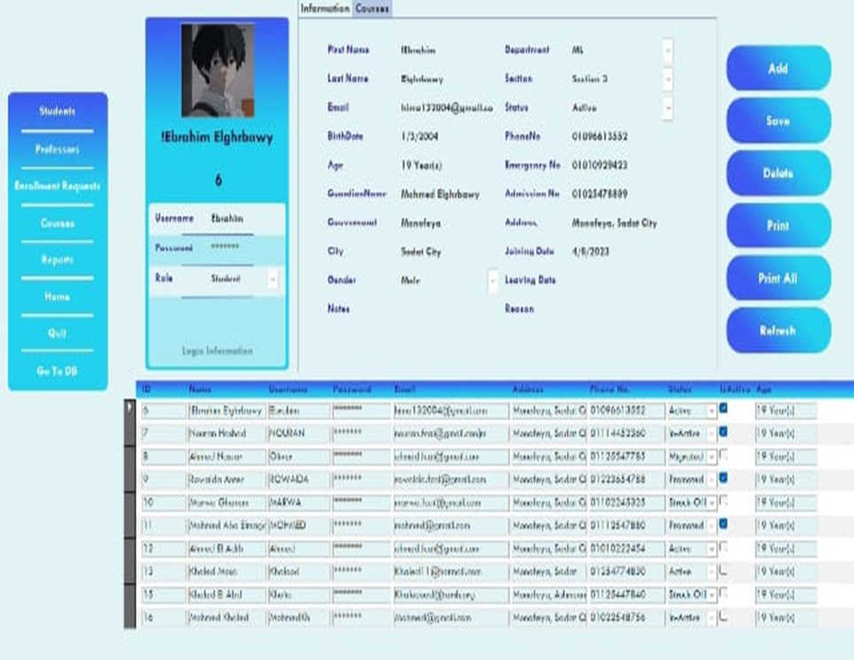
FORM ADMIN TEACHER
FORM ADMIN STUDENT

Slide 19
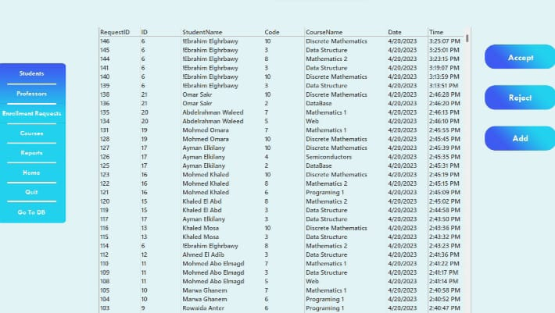
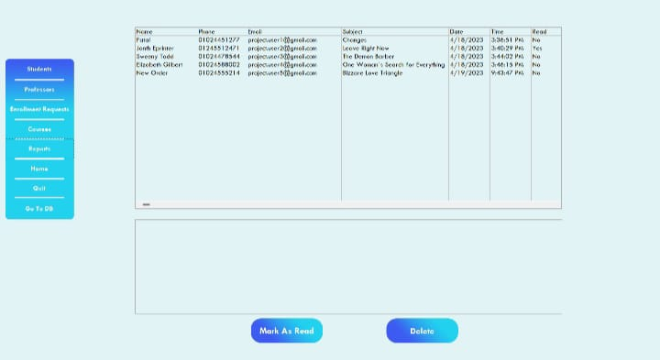
ENROLLMENT REQUEST TEACHER
FROM ADMIN REPORT

Slide 20
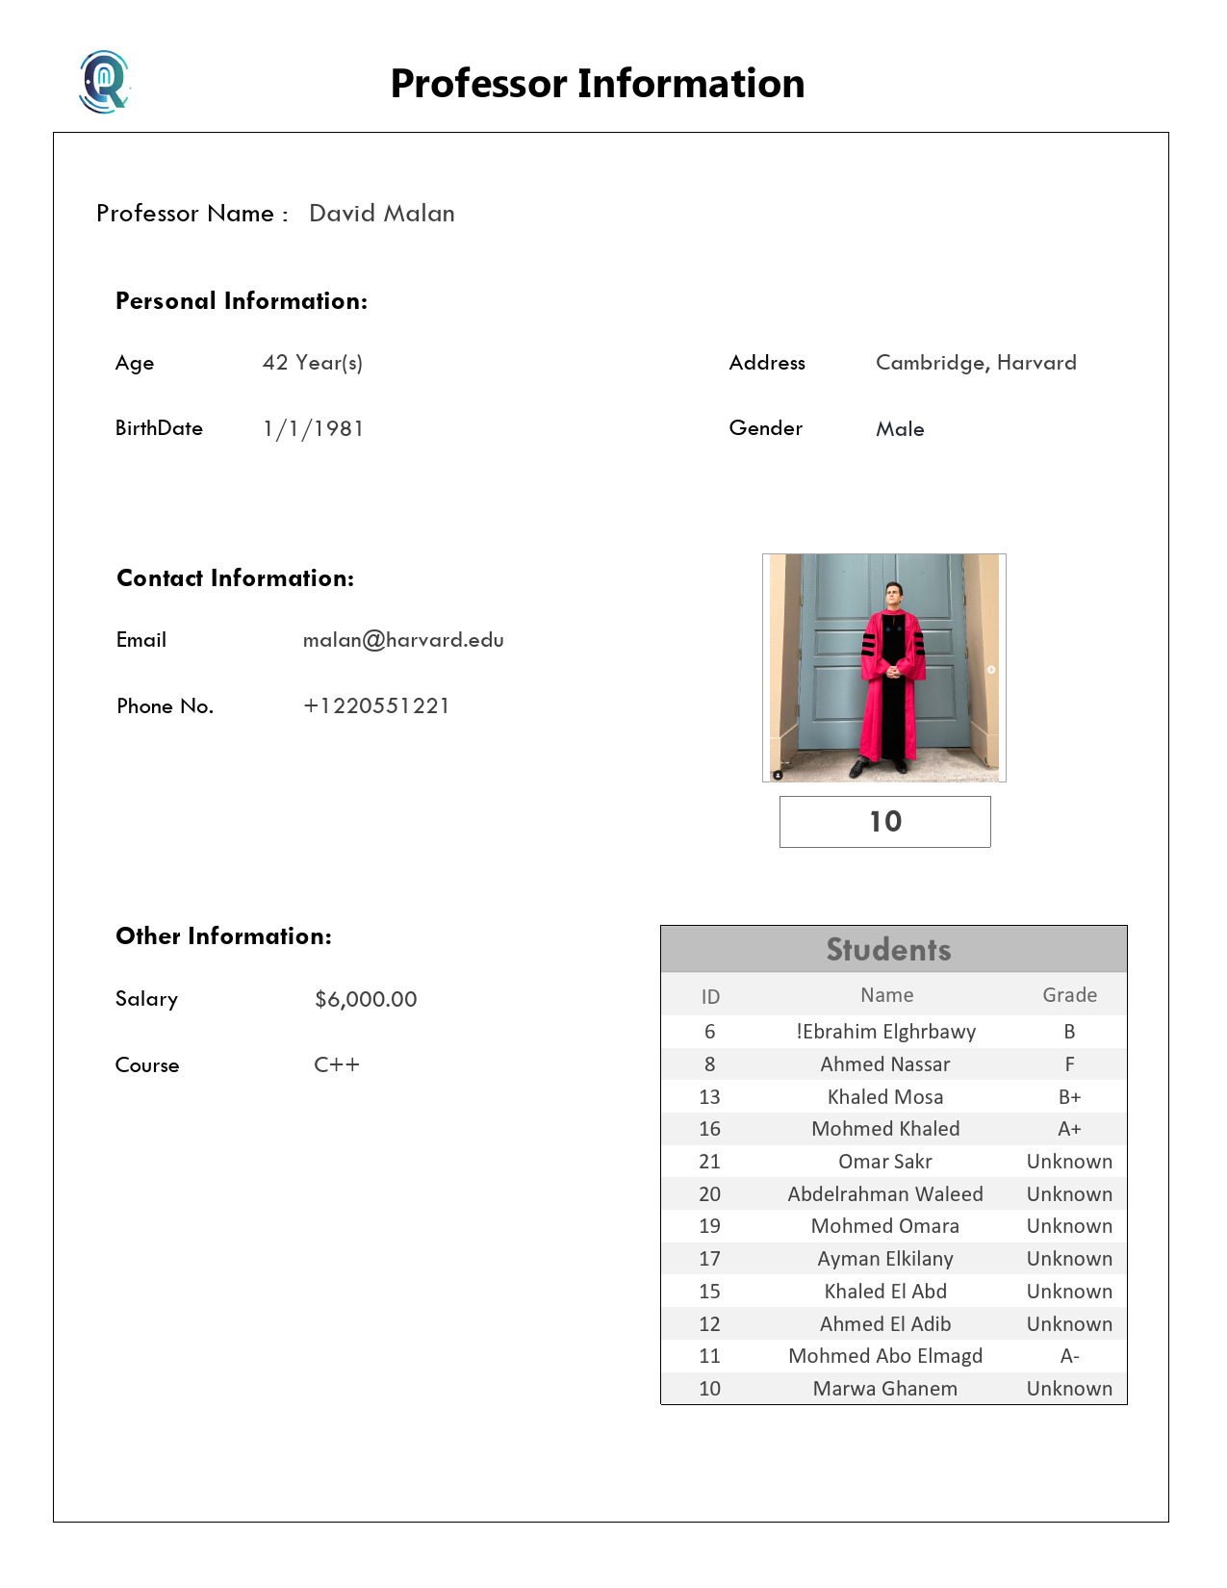
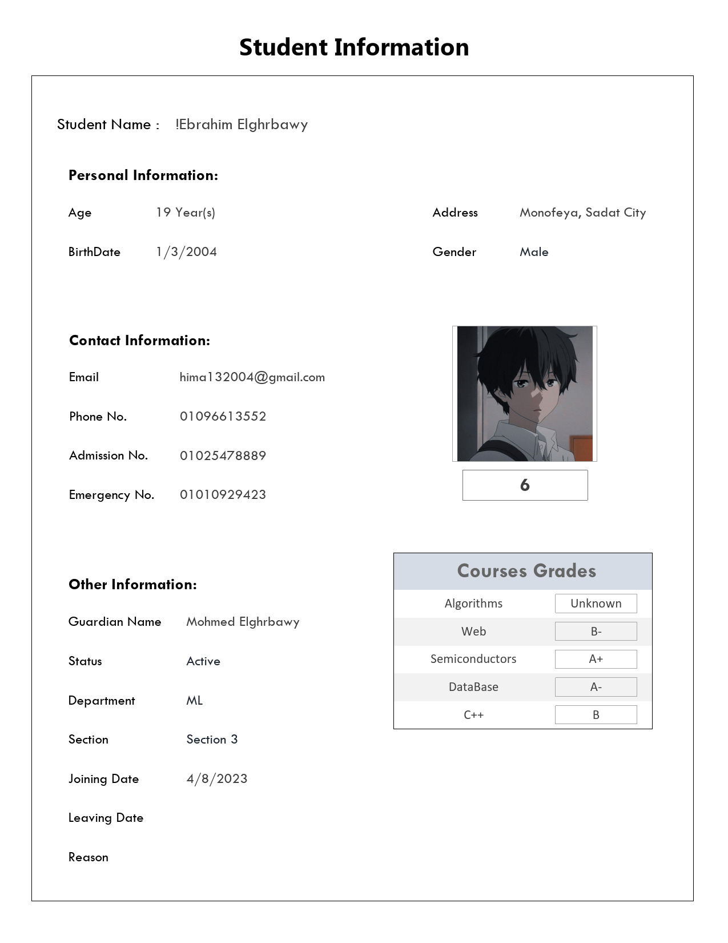
REPORTS

Slide 21
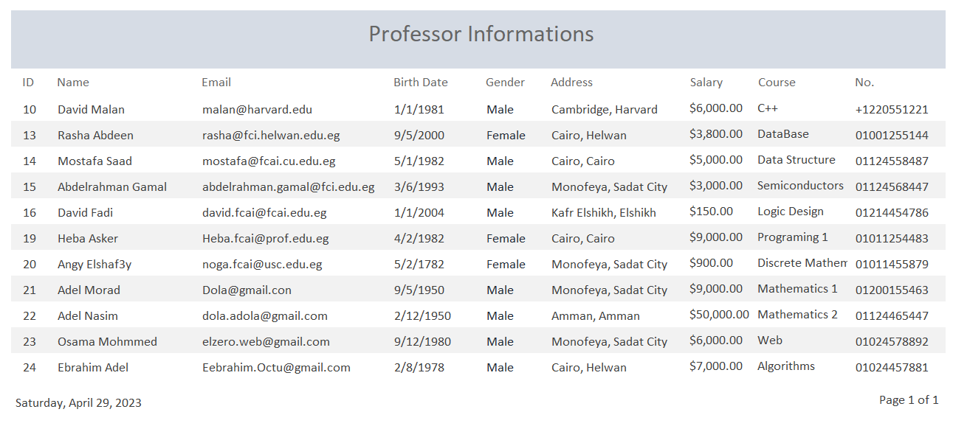
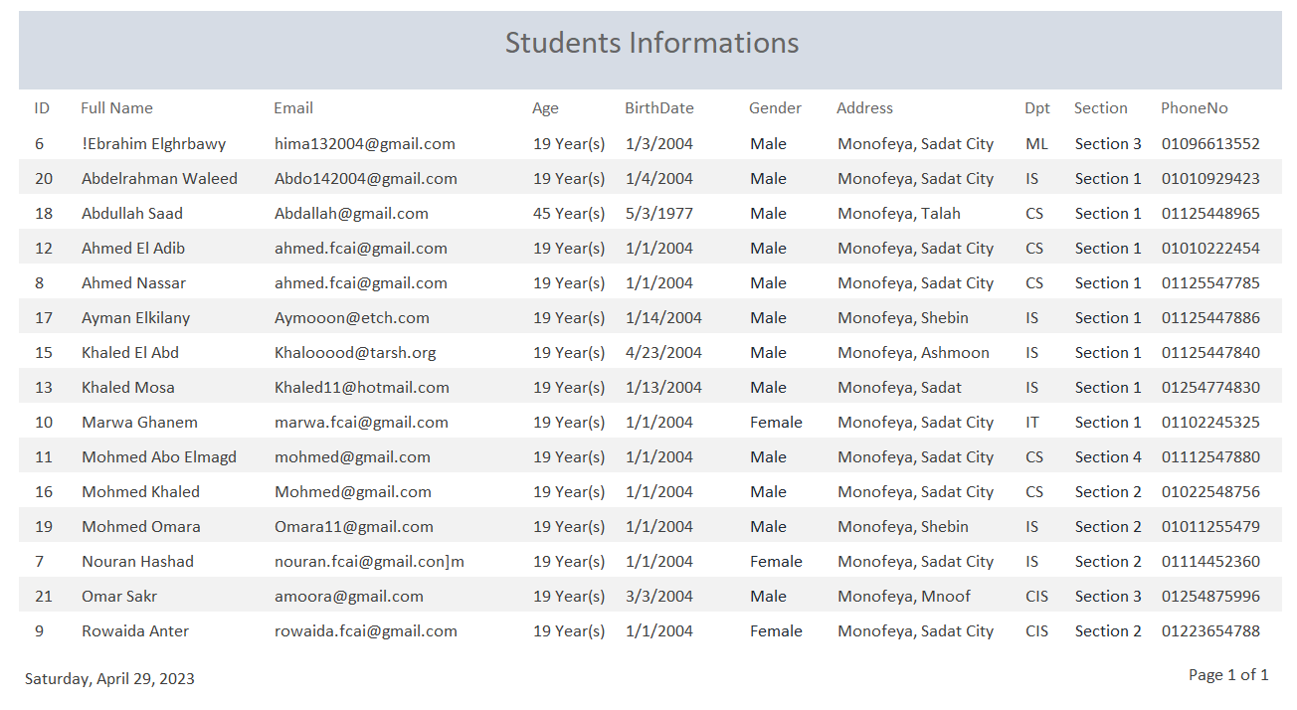

REPORTS

Slide 22
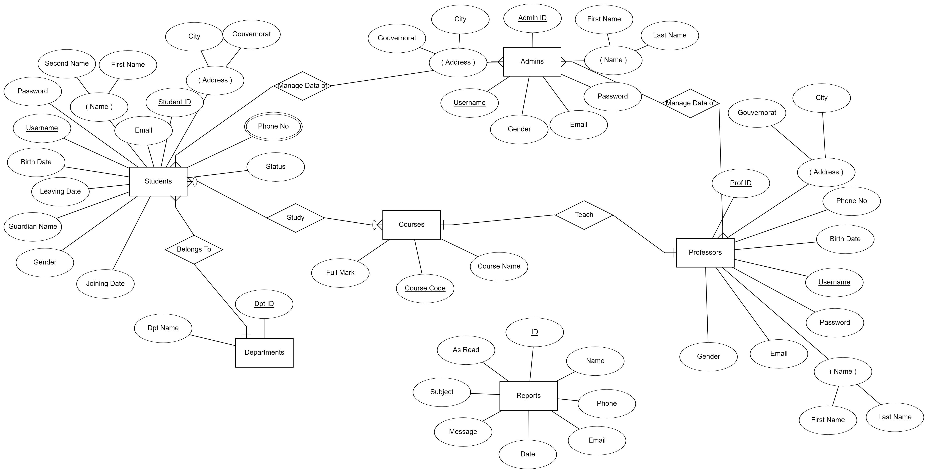
ERD

Slide 23
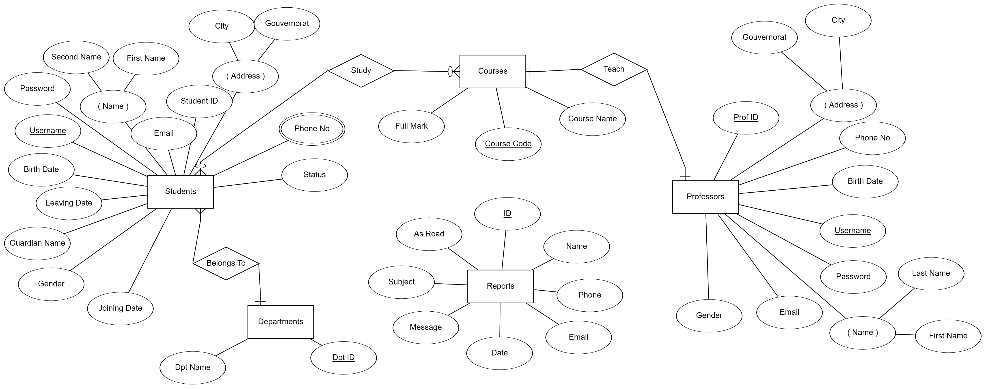
ERD

Slide 24
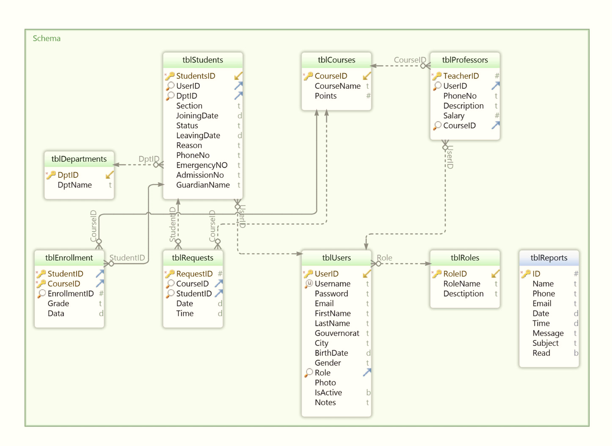
Shema

Slide 25
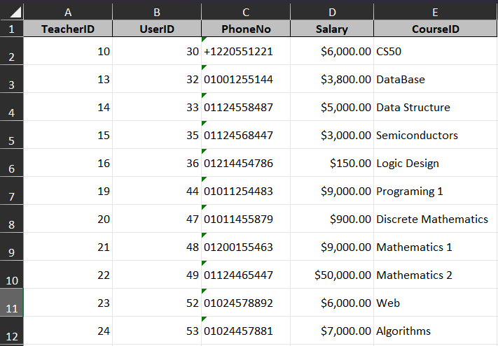
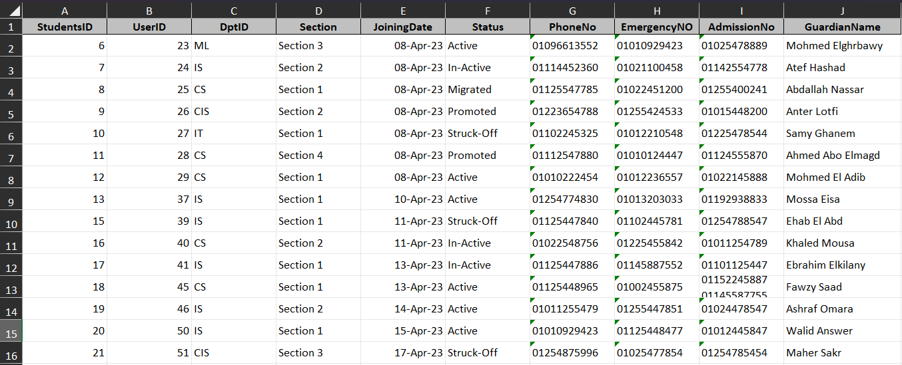
Professors
TABLES
Students

Slide 26
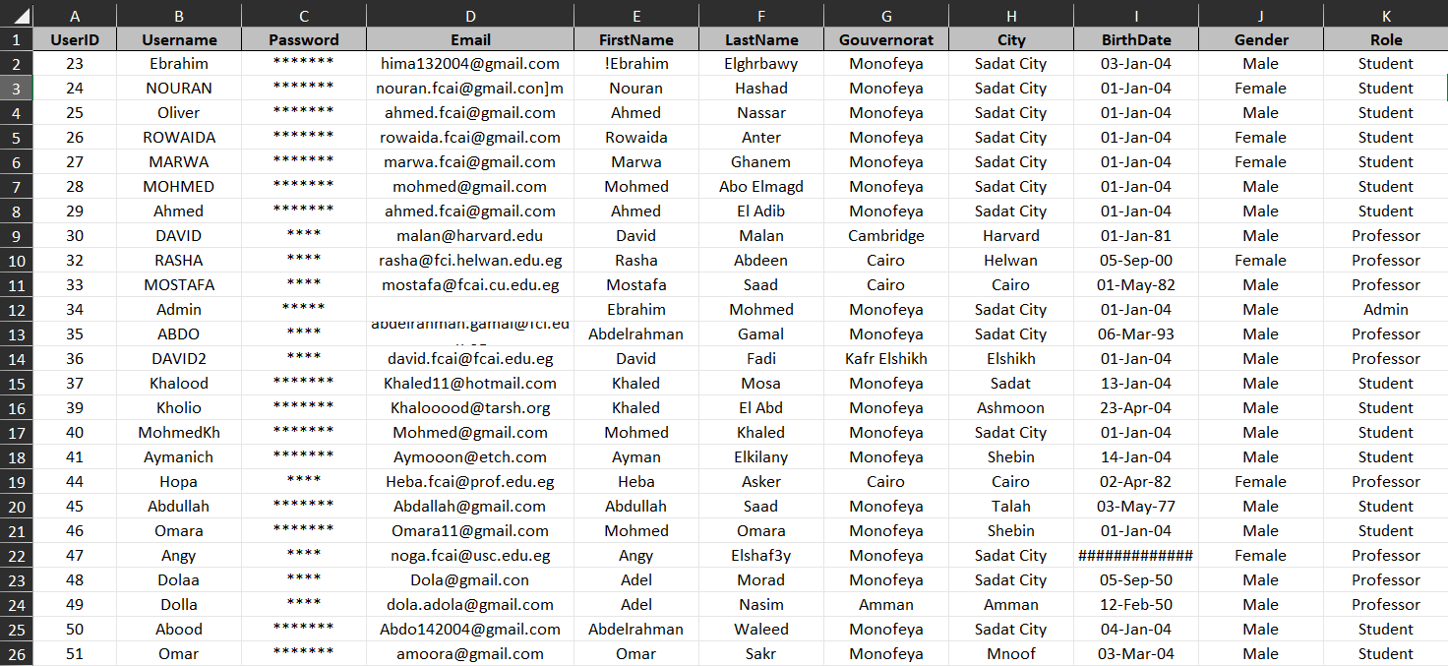
TABLES
Users

Slide 27
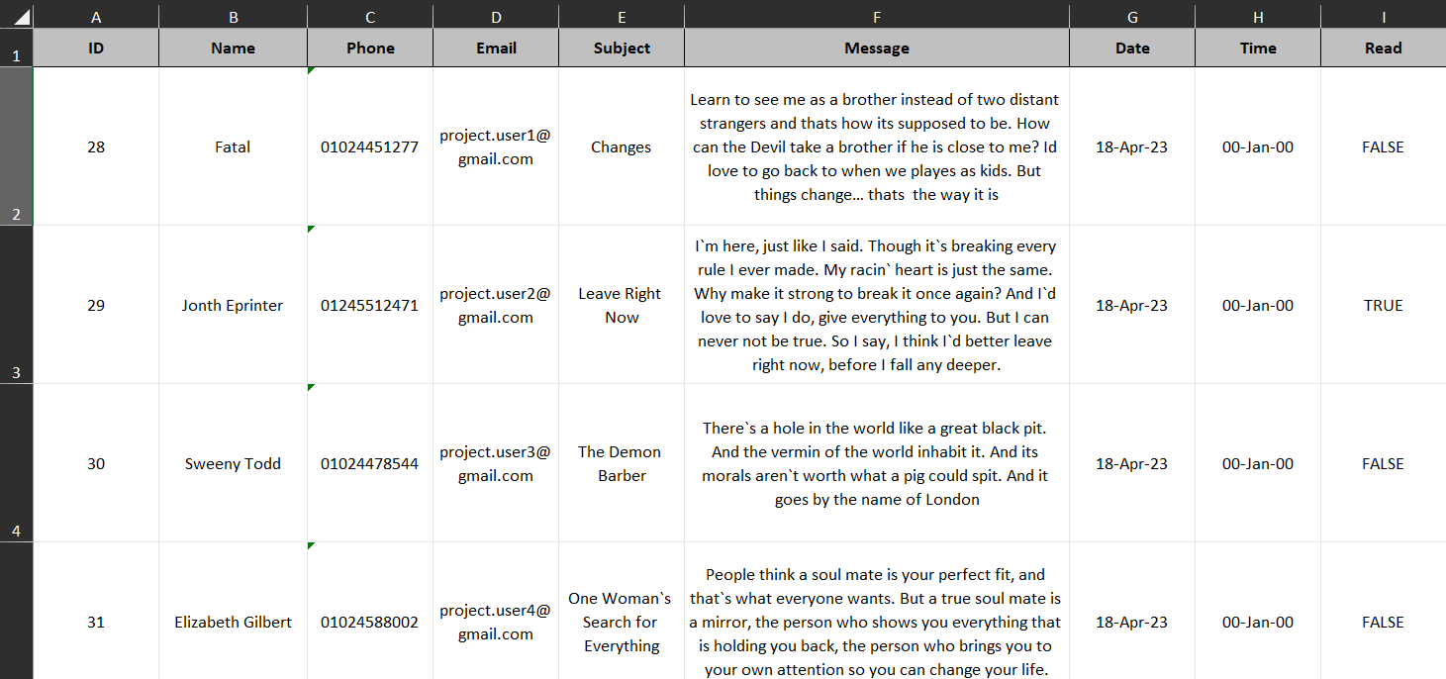
TABLES
Reports

Slide 28
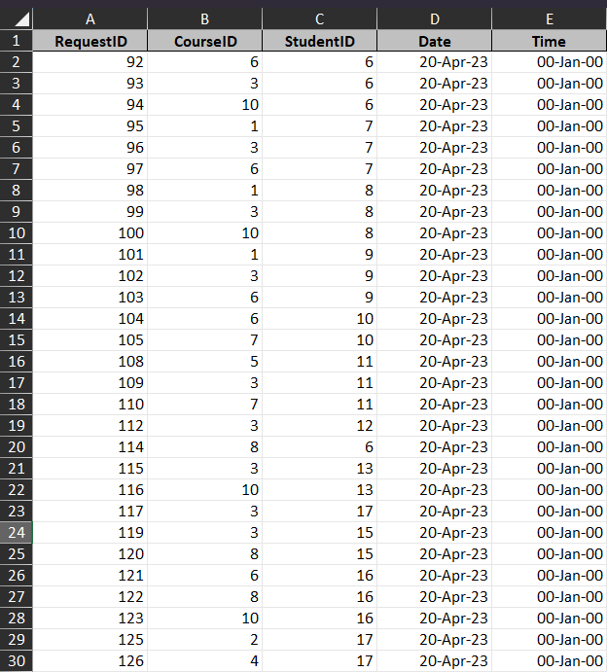
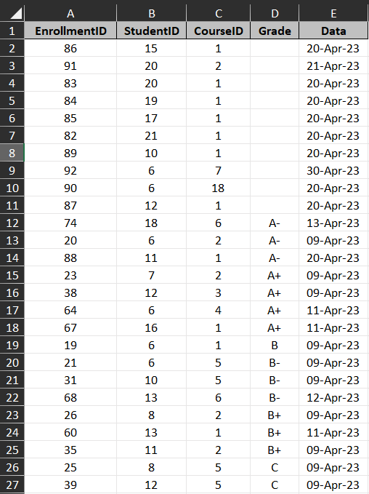
TABLES
Requests
Enrollments

Slide 29






Queries
Select All Information About Students In tables And Age, Full Name….
Select All Information About Professors In tables And Age, Full Name….
Select each Student With his Courses, Grade
Select Courses not Enrolled by each Student.
Select Courses not Selected by Professors, No one teach it.
Select Course Name and Student Name in Requests Table.

Slide 30
Queries
Select All Information About Students In tables And Age, Full Name….
Select All Information About Professors In tables And Age, Full Name….
Select each Student With his Courses, Grade
Select Courses not Enrolled by each Student.
Select Courses not Selected by Professors, No one teach it.
Select Course Name and Student Name in Requests Table.

Slide 31
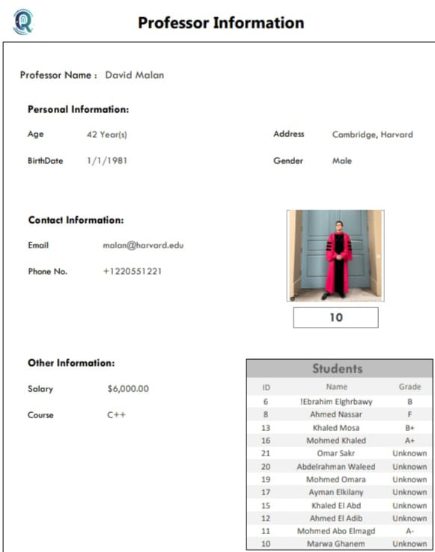
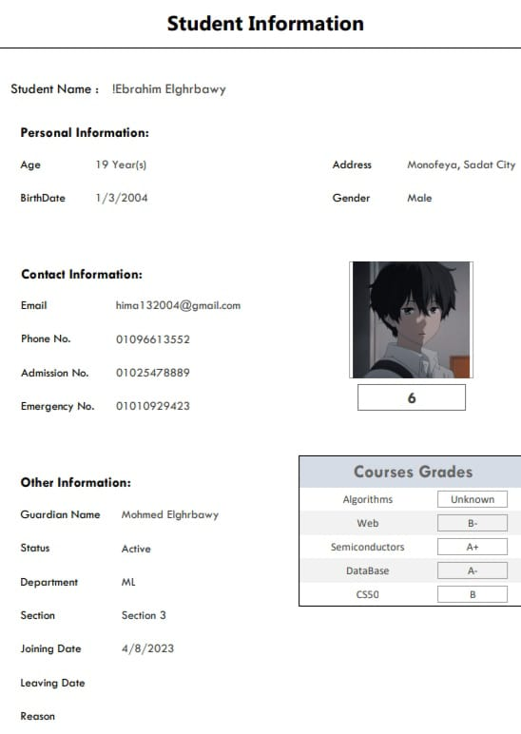
REPORT STUDENT EBRAHEIM @@ REPORT PROFESSOR DAVID

Slide 32

Out Of Range team

